Slide 1





Design of a real-time gesture recognition embedded system based on an Electromyography sensor and pruned Extreme Learning Machine algorithm
Presented by: Khouloud Matri
Supervisors: Prof. Dr.-Ing. Olfa Kanoun
Prof. Ahmed Fakhfakh
Prof. Salwa Sahnoun
Dr.-Ing. Rim Barioul
12.10.2024

Slide 2

Plan
Introduction and motivation
State of the art
Implementation of State-of-the-Art Segmentation Techniques
Proposed solution
Hand gesture classification algorithm
Implementation of hand gesture classification algorithm
Conclusion

Slide 3

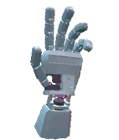
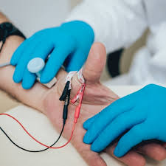


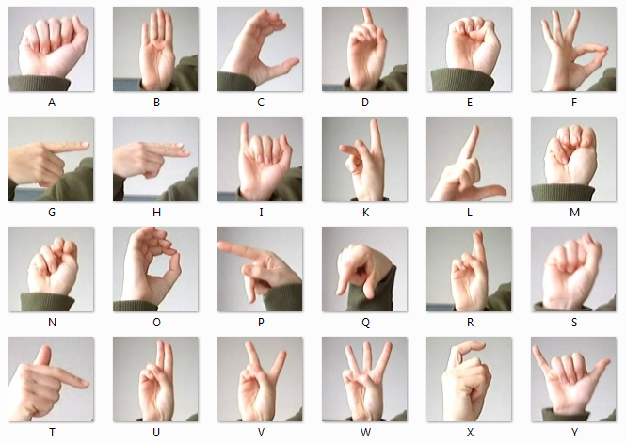
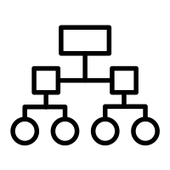

Introduction and motivation
Real-time gesture recognition
[1]
Data Acquisition
Pre-processing
Real-time gesture recognition system
Virtual Reality (VR)
Human-computer interaction
Clinical applications
Classification (AI)
Features extraction
Sign language recognition

Slide 4
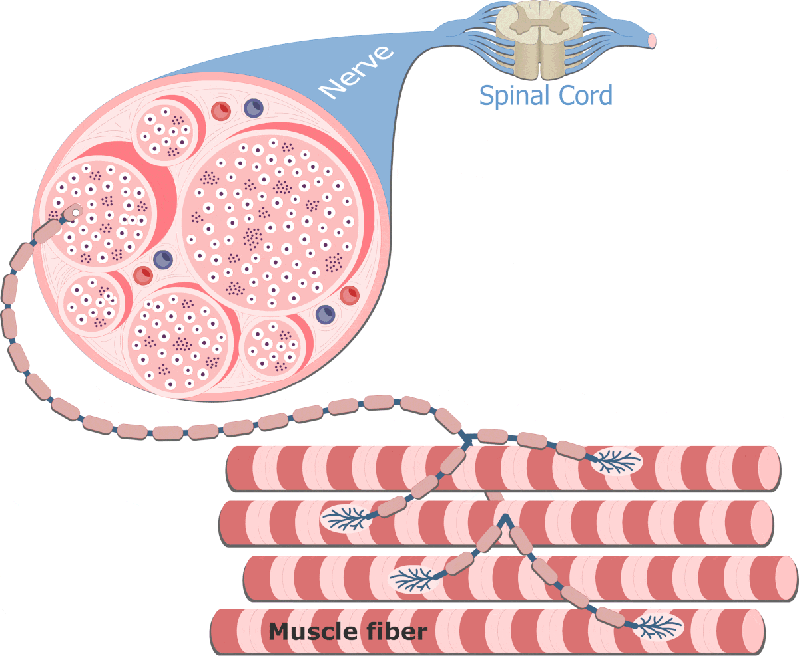
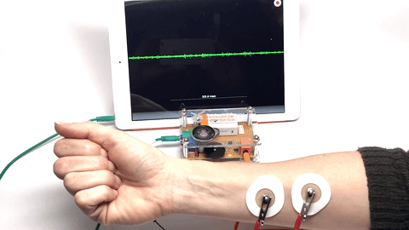
Introduction and motivation
Elecromyography
[1,2]
Motor Unit
Motor Unit Action Potential (MUAP)
Physiological signal Detected even before the end of the gesture performance
Diagnostic technique
Recording electrical muscle activity
Higher real time feasability

Slide 5

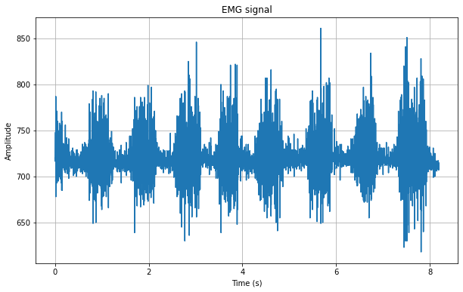
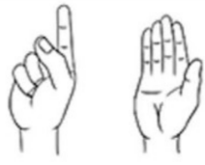
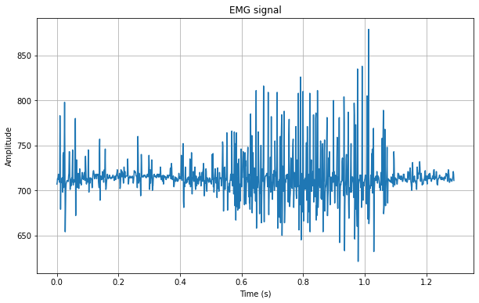

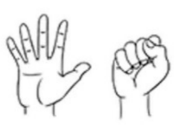
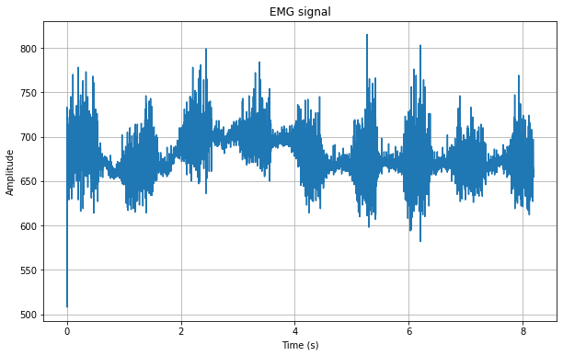
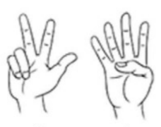
Introduction and motivation
Our focus:
Dynamic signal segmentation
Low complexity of signal processing
Wearable gesture classification system
Goal: High-performance and responsive real-time system for dynamic gesture recognition.
Wearable system for real time continious classification of hand gestures based on EMG signals
Direct control of systems
Ability to react quickly to unexpected events
Challenges:
Improved user experience with instant feedback
Dynamic gesture segmentation
Timing constraints
Model complexity constraint

Slide 6
State of the art: segmentation techniques
Segmentation Techniques |  | Procedure | Benefits | Limitations
Conventional amplitude [1,7] |  | Fixed amplitude threshold | Simple and intuitive approach Low computational complexity | Susceptible to noise and interference
CUSUM algorithm [8] |  | Comparison between the cumulative sum Sk and an adaptive threshold | One of the best algorithms for detection when parameters are known | Can't detect spectral changes with unknown parameters
Dynamic cumulative sum(DCS) [8, 9] |  | Local cumulative sums between hypotheses around time t. | Effective for detection of changes in signals of long duration | Window width choice affects it, can't detect close changes
Modified dynamic cumulative sum (MDCS) {8,10] |  | Automatic threshold (distribution of the Kullback–Leibler) | Fast, suited for long signals, no prior event knowledge needed | Sensitive to Window width
Teager-Kaiser Energy Operator | Fixed threshold[7,11] | Detection based on a fixed energy threshold. | Effective for non-stationary signals Simplicity in implementation | Sensitive to noise and interference
 | Adaptive threshold [12,13] | Detection based on an adaptive energy threshold. | Adaptability to varying signals, efficient for real-time use | Computational Complexity

Slide 7
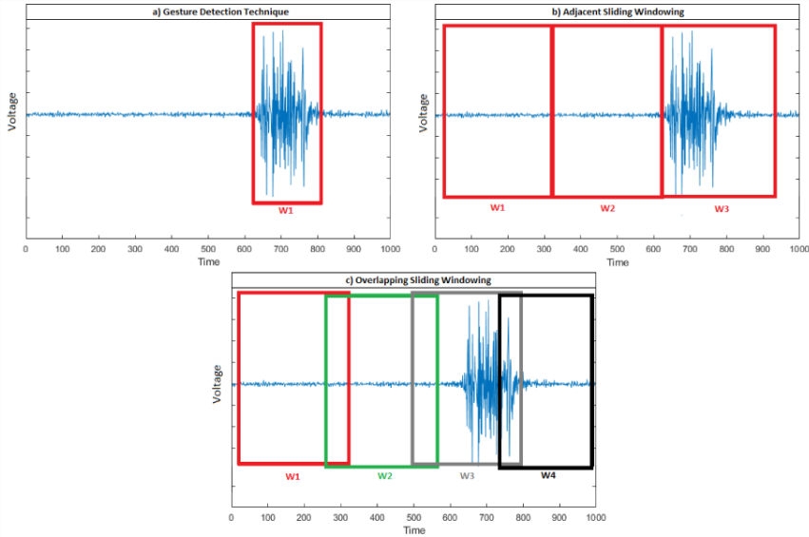
State of the art: segmentation techniques
Techniques for sEMG signal segmentation [1]
Adjacent sliding windowing
Overlapping sliding windowing
Goal: Gesture detection
[1]
Optimal: minimum classification error, suitable controller delay [1] | Accelerate decision(fast and dense) Improved accuracy of prediction[1,14]
Too long sequence may cause system long processing delay | Complexity in Implementation Redundancy and Increased Data Size
More suitable for dynamic gesture recognition

Slide 8
State of the art: pruning techniques
Methods | Examples | Procedure | Benefits | Limitations
Penalty term methods[18,19] | Rudy Setiono: penalty function | Adding a penalty term to the objective function to be minimized Smaller weights forced to zero | Robust to noise | Eliminating crucial weights Creating additional local minima on the error surface.
Magnitude[20,21] based methods | Hagiwara strategies | Small weights are irrelevant (Based only on weight magnitude ) | Less sophisticated Less computational time | Removing important parts. Low efficiency.
Mutual [22] Information (MI) based methods | Xing-Hu | Determining the optimal number of hidden units, based on the rank of the covariance matrix. | Good optimization: pruning both input and hidden units | Less adaptable for real-time tasks
Evolutionary pruning methods [23,24] | Whitley-Bogart | Genetic Algorithms | Fewer parameters Improving generalization Flexibility, global optimization | -
Sensitivity Analysis (SA) b-methods[25] | OBD OBS | Pruning the weight or node with least effect on the objective function | - | Additional computation (Hessian matrix)
Significance {26] pruning methods | N2PS | Elimination of nodes with low significance value(threshold). | Remove both irrelevant input and hidden nodes. | -

Slide 9
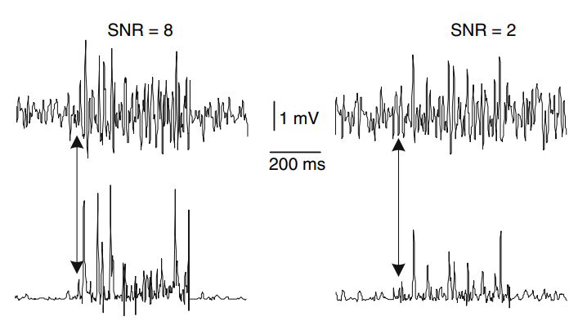
Implementation of State-of-the-Art Segmentation Techniques
Teager-Kaiser Energy Operator (TKEO)
[7, 15 ,16]
Ψ[x(n)] = x^2(n) - x(n+1)x(n-1)
Energy variations in the signal
Tracking instantaneous energy or amplitude and frequency changes in the signal.
sEMG
signals
x(n) = Acos[ω0(n) + θ]
where n : sequence index
x : raw EMG signal
θ : initial phase
TKEO
signals
Onset/Offset Detection
Notes:
Computing the difference between the squared amplitude of the current sample and the product of the neighboring samples.
show the onset time of the muscle activity

Slide 10

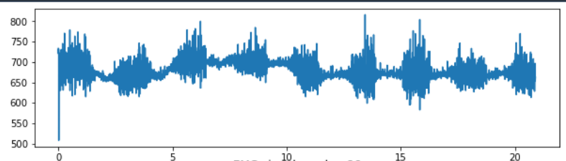
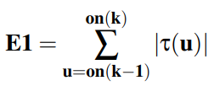
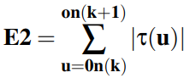
Implementation of State-of-the-Art Segmentation Techniques
Algorithm:
[12]
n=0, k=0
n+=1
If n > 2*w
TKEO_past
τ(n−w : n)
x(n)
TKEO
TKEO_future
τ(n : n+w)
τ(n) = x(n)** 2 −x(n−1)x(n+1)
TKEO_buffer
Correlation
If |r(n)| <= 0,01
If k >3 ( 4 changes)
Approximately = 0
r(n) = corr(|τ(n−w : n)|,|τ(n : n+w)|)
on_index.append(n-w) Store changes
prE
E1
E2
1
2
3
4
changes

Slide 11

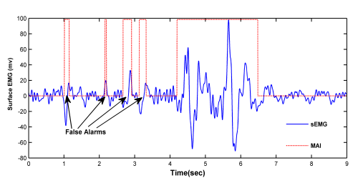
Implementation of State-of-the-Art Segmentation Techniques
Algorithm:
[12]
prE E1 E2
If maxE < E1:
maxE = E1
If E1 > 2* prE:
onset = change2
Else: onset = change3
Small width active regions => False alarms
1 2 3 4
prE E1 E2
If E2 < E1 and E2 > maxE* 0,05: offset = change4
If offset – onset > Fs/2:
Valid segment
1 2 3 4
Notes:
Nyquist theorem : if the highest frequency component of the muscle contraction signal is f, the sampling rate should be at least 2f

Slide 12
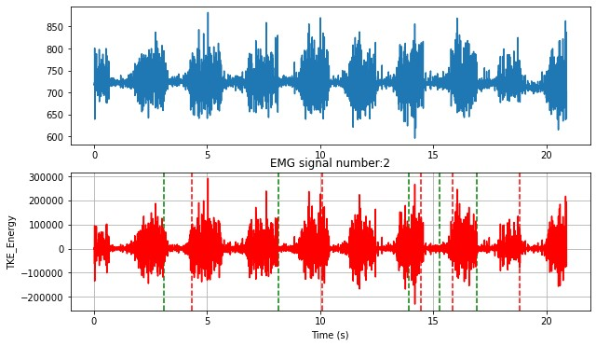
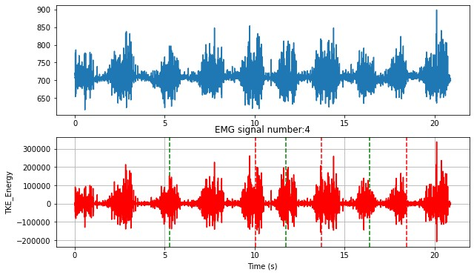

Implementation of State-of-the-Art Segmentation Techniques
Green line => onset Red line => offset
Onset / Offset : not accurately positioned
Segmentation: not effective

Slide 13

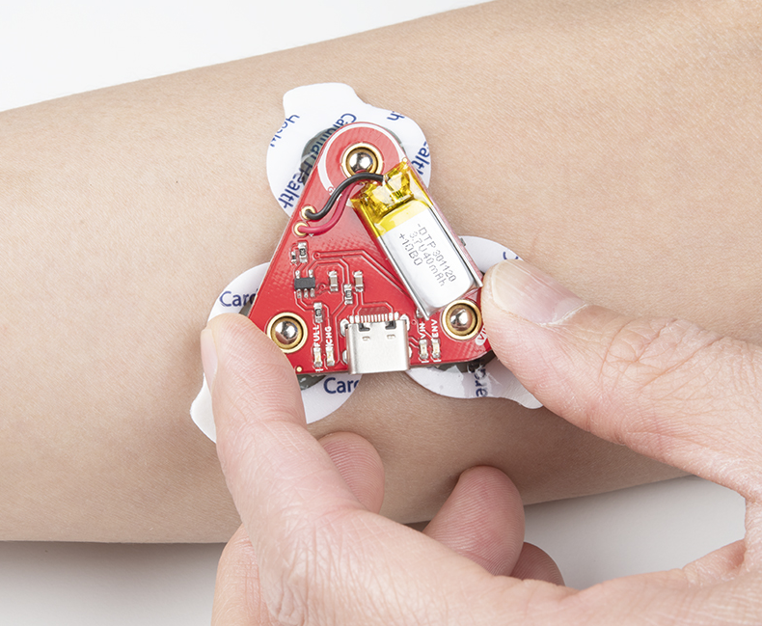
Proposed solution
Trained Model
Training of model
Pruned-ELM algorithm
Offline Computer based processing
Saving training data
Online gesture classification
Data transmission
On-Board processing
Segmentation: proposed modified TKEO with adaptive threshold
Features
Extraction
Testing model
New data
Testing time
Time domain:
Fast
Low complexity
sEMG sensor
TKEO: Teager-Kaiser Energy Operator
Real-time application

Slide 14
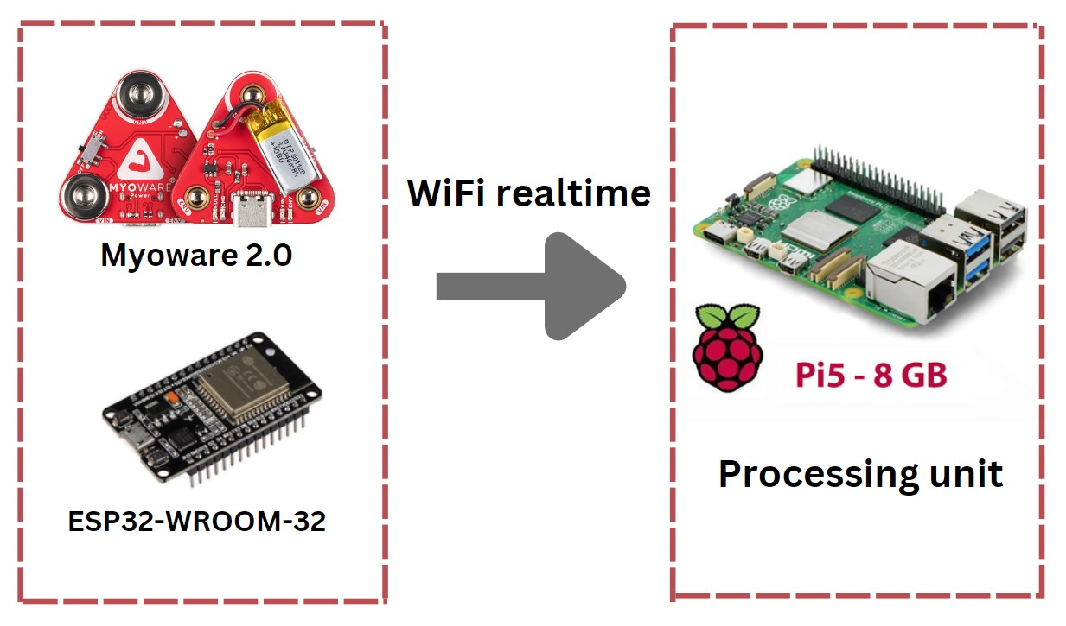
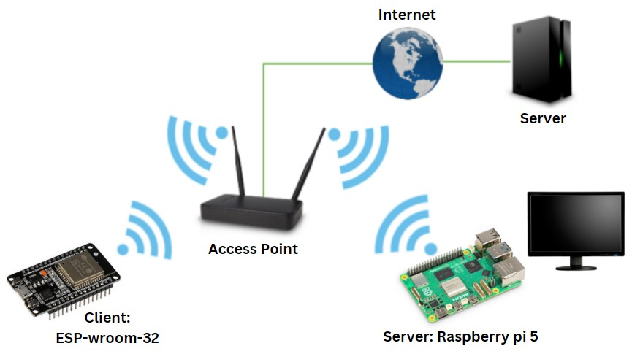
Proposed solution
System architecture
Wireless, wearable EMG sensor
[3,4]
Sampling rate =1000Hz [5]
Low power consumption
Station mode: set as a client
Powerful CPU; for real-time data processing [6]
Raw EMG signal => Detailed representation
=> Accurate analysis
Dual-band wifi: stable and fast communication
TCP/IP address [5]
Notes:
This raw data is critical for accurate analysis and classification of hand gestures, as it offers the most detailed representation of the muscle’s electrical activity.
Esp32 well-suited for wireless communication tasks
Achieve sampling rates sufficient to handle high-frequencyEMG signals
Devices that support dual-band WiFi can switch between these two frequency bands to balance speed and range for optimal performance.
2.4 GHz band: Offers a wider coverage area but lower data speeds(more interference from other devices)
5 GHz band: Provides faster data rates and less interference

Slide 15
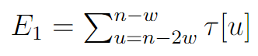
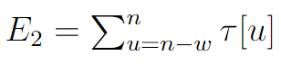
Proposed solution
Proposed modified sEMG segmentation Algorithm:
E1 E2
E1 E2
=> Fixed energy interval
n-2w n-w n
n-2w n-w n
Only 1 change
Only 1 change
if E2 > 2 * E1 :
onset_index.append(n-w)
if E1 > 2 * E2:
offset_index.append(n-w)

Slide 16
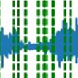
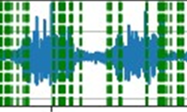
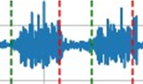
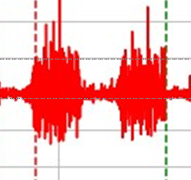
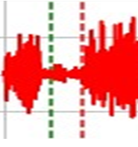
Proposed solution
Old version
New version
Improved Accuracy
Detecting noise
Onset <-> offset

Slide 17
Proposed solution
New version
Old version
New version
E1
E2
prE
E1
E2
E1
E2
w
1
w
1
2
3
4
4 changes
w
1
w
1 change
prE
E1
E2
No need to wait for the next change
window
1
2
3
4
4 changes
Fixed latency
Low latency
Improved real-time application

Slide 18
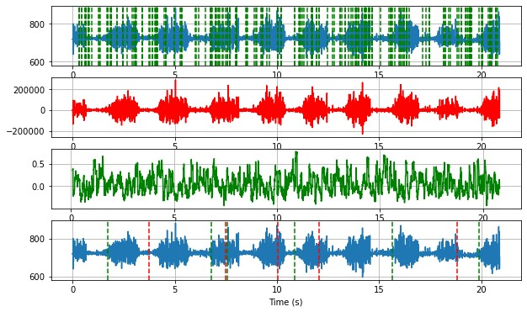
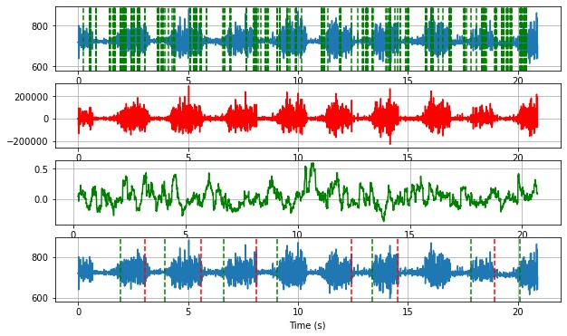
Proposed solution
Offline segmentation
Window width investigation:
w = 30
if E2 > 2 * E1
w = 80
if E2 > 2 * E1

Slide 19
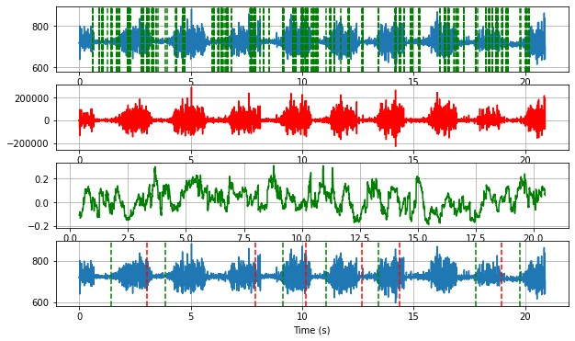
Proposed solution
Offline segmentation
Window width investigation:
w = 80
if E2 > 2 * E1
w = 150
if E2 > 2 * E1

Slide 20
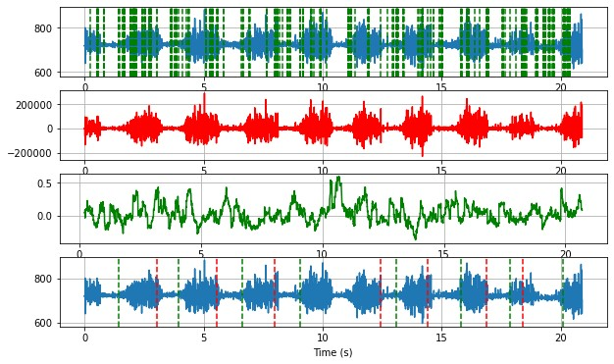
Proposed solution
Offline segmentation
Energy coefficient investigation:
w = 80
if E2 > 1.5 * E1
w = 80
if E2 > 2 * E1

Slide 21
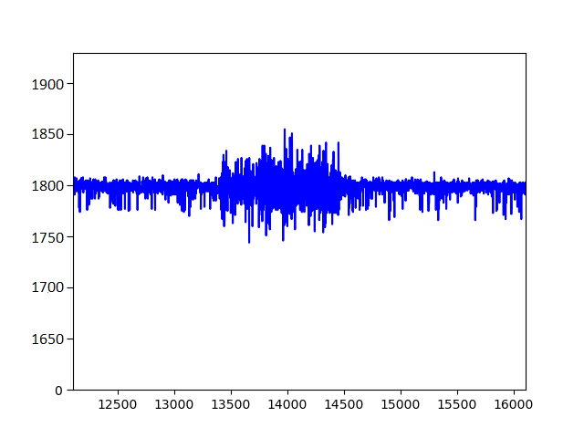
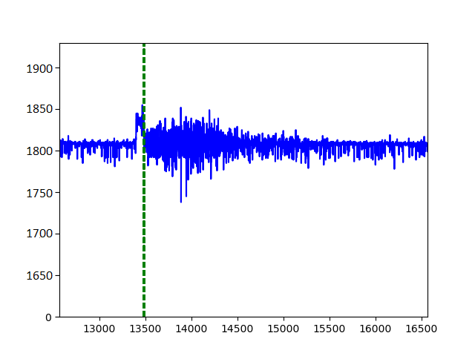
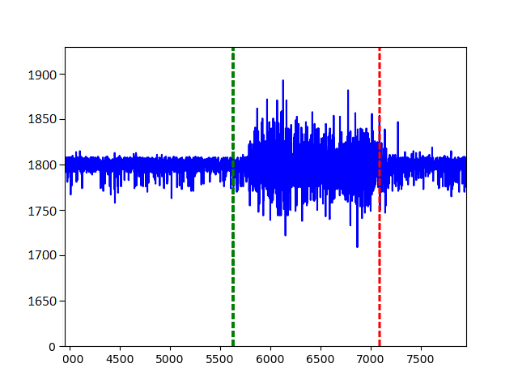
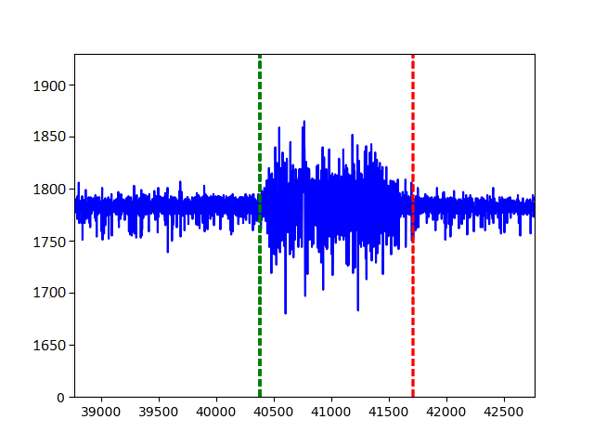
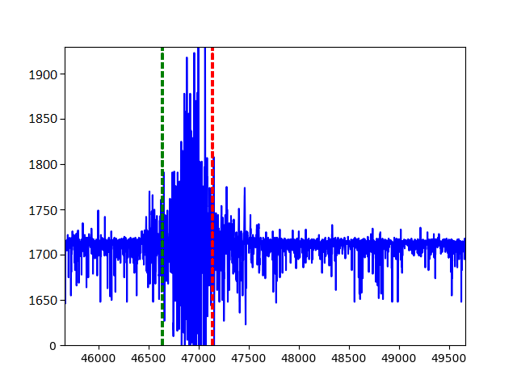
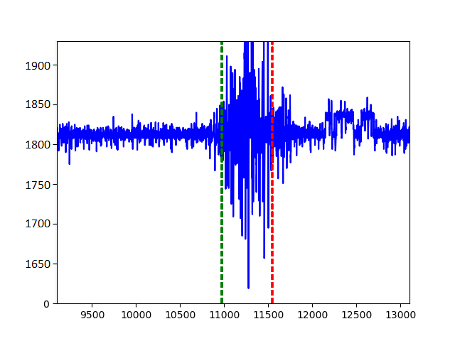
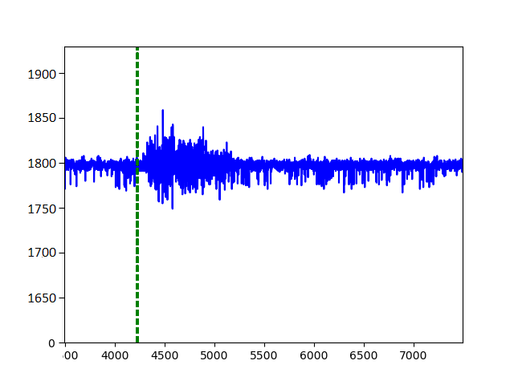
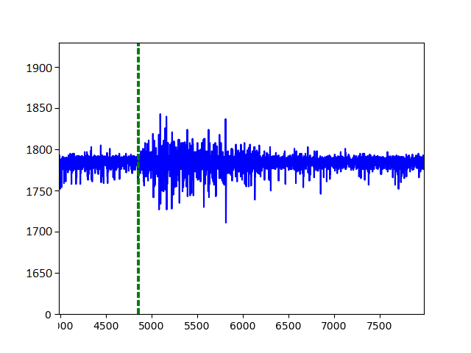
Proposed solution
Real time application:
Window width investigation:
C1=2 C2=2
w= 300
w= 80
w= 250
w= 320

Slide 22
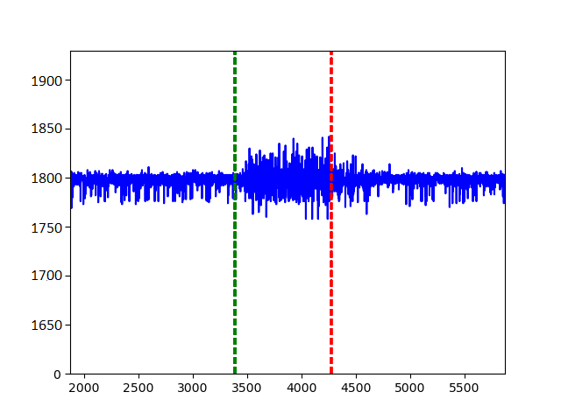
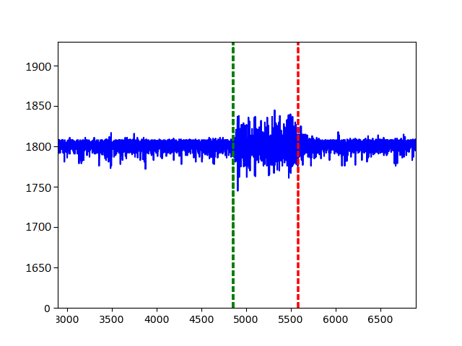
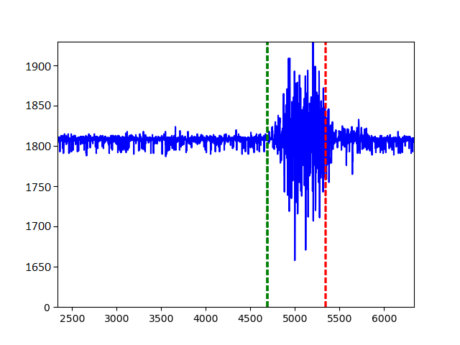
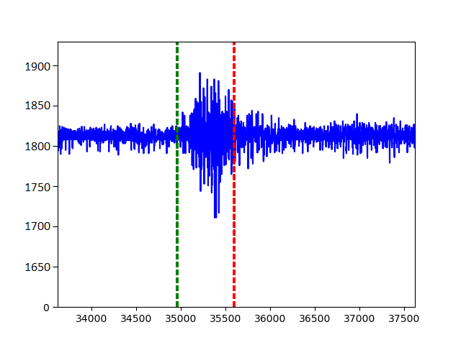
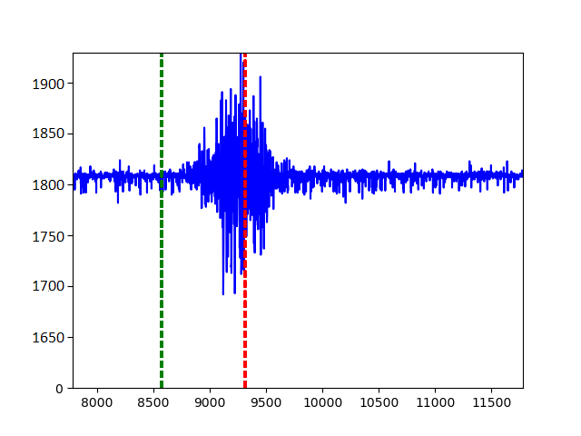
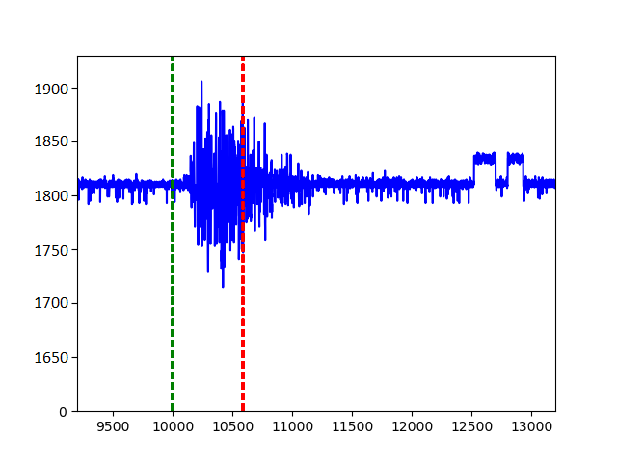
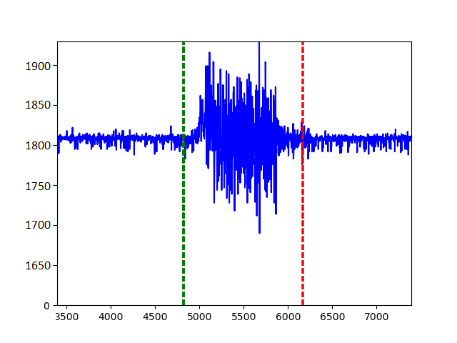
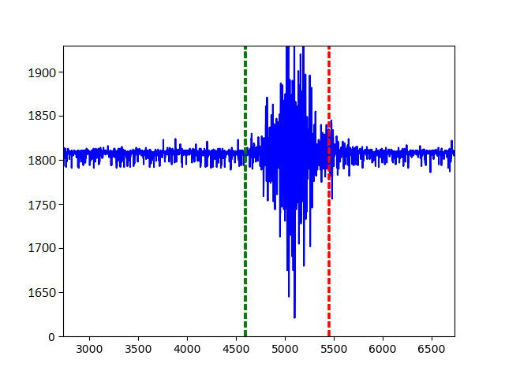
Proposed solution
Real time application:
Energy coefficient investigation:
Window size=300
C1=2
C2=2
C1=1.5
C2=1.5
C1=1.5
C2=2
C1=1.5
C2=1.3

Slide 23






Hand gesture classification algorithm
Data collection (Raw signals)
Gesture 1
Gesture 2
1 subject
45 times
Gesture 3
Gesture 4
Gesture 5

Slide 24



Hand gesture classification algorithm
Feature extraction
RMS (Root Mean Square)
MAV (Mean Absolute Value)
WL (Waveform Length)
WAMP (Willison Amplitude)
ZC (Zero Crossing)
Redundant Features
RMS and MAV
WL and WAMP
Non-Informative Feature: ZC
Values = 0.0
10 Retained Features
Notes:
Rms=mav
Wl= wamp

Slide 25
Hand gesture classification algorithm
Extreme Learning Machine (ELM):
[1] [14]
wi
b1
βi
A single hidden layer feedforward neural network
wi and bi : Randomly assigned
Only βi : Learned
X1
b2
O1
X2
b3
Om
Xn
̂
bN
Input layer
Hidden layer
Output layer
ELM
Fast convergence speed
Promising performance
Learning without iteration
Applications:
Classification
Regression
Clustering
Feature mapping

Slide 26

Hand gesture classification algorithm
Pruning
[17]
Removing irrelevant or less relevant nodes.
Removing weights.
Before
After
Before
After
Reduction of Complexity
Objective:
Fast response.
Robust prediction accuracy.
Size Reduction
Advantages
Efficiency Enhancement
Prevent overfitting
Improvement of Generalization

Slide 27



Hand gesture classification algorithm
GAP-ELM (Genetic Algorithm Pruned Extreme Learning Machine):
[24]
ELM architecture design
α ∈ [0, 1]
Genetic Algorithm
Goal : Maximizing both:
Accuracy
Pruning rate

Slide 28
Implementation of hand gesture classification algorithm
Investigation of GAP-ELM performance based on N° of HN before and after pruning:
Algorithm | N° of HN before pruning | N° of HN after pruning | Training Accuracy | Testing Accuracy | Training Time (s) | Testing Time (s)
GAP-ELM (α= 1,00) | 5 | 3±2 | 92,65±6,54 | 91,35±5,94 | 1,0234±0,125 | (0,4578±0,0773)*10-3
 | 10 | 4±4 | 99,61±0,39 | 96,8±4,7 | 1,328±0,171 | (0,515±0,085)*10-3
 | 50 | 24±5 | 100 | 100 | 4,958±0,885 | (0,549±0,071)*10-3
+
Accuracy
N of HN before pruning
=
Number of hidden neuron at initialization
Training Time
Testing Time
Still low enough for real time classification
-
Notes:
Regularization: If your model has a strong regularization term (like L2 regularization), it might be underfitting the training data but generalizing well to unseen data.

Slide 29


Implementation of hand gesture classification algorithm
GAP-ELM confusion matrix:
HN=5
HN=10

Slide 30
Implementation of hand gesture classification algorithm
Comparison between ELM and GAP-ELM:
Number of hidden neuron at initialization= 50
Algorithm |  | N° of HN after training | Training Accuracy | Testing Accuracy | Training Time (s) | Testing Time (s)
ELM |  | 50 | 98,9±1 | 94± 3,33 | (6,065 ±0,005)*10-3 | (0,95±0,25)*10-3
GAP-ELM | α= 1,00 | 24±5 | 100 | 100 | 4,958±0,885 | (0,549±0,071)*10-3
 | α= 0,96 | 46±2 | 100 | 100 | 4,957±0,789 | (0,596±0,066)*10-3
 | α= 0,93 | 47±1 | 100 | 100 | 4,894±0,678 | (0,602±0,073)*10-3
 | α= 0,9 | 47±1 | 100 | 100 | 4,87 ± 0,335 | (0,606±0,057)*10-3
 | α= 0, 8 | 48±1 | 99,8±0,2 | 96,66±3,33 | 4.128±0,25 | (0,612±0,086)*10-3
 | α= 0,7 | 49±1 | 64,28±35,71 | 61,11±38,89 | 3.884±0,32 | (0,623±0,0773)*10-3
Accuracies comparables to ELM
significant reduction of neurons
α increase ➔GAP-ELM accuracies increase
Number of hidden neurons decrease
Training Time increase
Testing Time decrease
Improved
real-time classification
Notes:
Regularization: If your model has a strong regularization term (like L2 regularization), it might be underfitting the training data but generalizing well to unseen data.

Slide 31


Implementation of hand gesture classification algorithm
GAP-ELM confusion matrix:
α= 1,00
α= 0, 7

Slide 32
Conclusion
Development and implementation of dynamic real time segmentation algorithm
Collection of EMG raw signals for 5 gestures
10 retained informative features
Implementation of ELM algorithm on the collected data
Development of genetic algorithm for pruned ELM accurate for real time application
Improved real time classification results comparing to ELM: Higher accuracies and lower testing time (range of milliseconds)

Slide 33
Reference
[1] Real-Time Hand Gesture Recognition Using Surface Electromyography and Machine Learning: A Systematic Literature Review
[2] Cram, J. R., Kasman, G. S., Holtz, J. (1998) Introduction to Surface Electromyography.Aspen Publishers.
[3] https://myoware.com
[4] Advancer Technologies. (n.d.). MyoWare Muscle Sensor - 2.0. Retrieved from AdvancerTechnologies
[5] Espressif Systems. (n.d.). ESP32 Technical Reference Manual. Retrieved from EspressifSystems
[6] Raspberry Pi Foundation. (n.d.). Raspberry Pi 5 Product Overview. Retrieved fromRaspberry Pi
[7] Teager–Kaiser Energy Operation of Surface EMG Improves Muscle Activity Onset Detection XIAOYAN LI , 1 PING ZHOU, 3,4 and ALEXANDER S. ARUIN1,2
[8] A segmentation approach to long duration surface EMG recordings Wassim El Falou a,b, Jacques Ducheˆne a , David Hewson a,*, Mohamad Khalil b , Michel Grabisch c , Fre´de´ric Lino d
[9] Uterine EMG Analysis: A Dynamic Approach for Change Detection and Classification Mohamad Khalil*, Associate Member, IEEE, and Jacques Duchêne, Senior Member, IEEE
[10] A segmentation approach to long duration surface EMG recordings Author links open overlay panelWassim El Falou ª ^{b}, Jacques Duchêne ª, David Hewson ª, Mohamad Khalil ^{b}, Michel Grabisch ^{c}, Frédéric Lino ^{d}
[11] Electromyogram analysis, William Rose, Updated 2011-04-27, 2012-04-13, 2014-02-19, 2014-07-23, 2019-10-24*
[12] A Robust and Adaptive Algorithm for Real-Time Muscle Activity Interval Detection using EMG Signals Rabya Bahadur1 and Saeed ur Rehman2
[13] Teager–Kaiser energy operator signal conditioning improves EMG onset detection
[14] Appropriate Feature Set and Window Parameters Selection for Efficient Motion Intent Characterization towards Intelligently Smart EMG-PR System Mojisola Grace Asogbon 1,2,† , Oluwarotimi Williams Samuel 1,2,† , Yanbing Jiang 1,2 , Lin Wang 1 , Yanjuan Geng 1,2, Arun Kumar Sangaiah 3 , Shixiong Chen 1,2, Peng Fang 1,2 and Guanglin Li 1,2,4,*

Slide 34
Reference
[15] Teager–Kaiser Operator improves the accuracy of EMG onset detection independent of signal-to-noise ratio
[16] Improving EMG Signal Change Point Detection for Low SNR by Using Extended Teager-Kaiser Energy Operator
[17] Huang et al. (2006) Optimization method based extreme learning machine for classification.
[18] Setiono, R. and Liu, H. (1997) Neural network pruning using genetic algorithms. IEEETransactions on Neural Networks, 8(3), pp. 573-579.
[19] LeCun, Y., Denker, J. S., and Solla, S. A. (1990) Optimal brain damage. In Advances inNeural Information Processing Systems, pp. 598-605.
[20] Hagiwara, M. (1993) Simplified neural network using magnitude-based pruning. IEEETransactions on Neural Networks, 4(4), pp. 586-594.
[21] Hassibi, B. and Stork, D. G. (1993) Second order derivatives for network pruning:Optimal brain surgeon. In Advances in Neural Information Processing Systems, pp.164-171.
[22] Xing, E. P. and Hu, X. (2002) Mutual information-based pruning of neurons in neuralnetworks. Neural Computation, 14(2), pp. 417-432.
[23] Deb, K. (2001). "Multi-Objective Optimization Using Evolutionary Algorithms." Wiley-Interscience.
[24] A new pruning method for extreme learning machines via genetic algorithms Alisson S.C. Alencar ^{b}, Ajalmar R. Rocha Neto ª, João Paulo P. Gomes ^{b}
[25] Sun, J., et al. (2002) Sensitivity analysis-based pruning in neural networks. Journal ofComputational Neuroscience, 13(1), pp. 75-89.
[26] He, Y., Zhang, X., and Sun, J. (2017) Channel pruning for accelerating very deep neuralnetworks. In IEEE Conference on Computer Vision and Pattern Recognition (CVPR), pp.1389-1397.

Slide 35
Thank you!

Slide 36

Pruning
Pruning from scratch
Reaching comparable performance
But reduced potential pruned structure space
(limited pruned structures) =>Pre-training phase: a cumbersome and time-consuming computation process
More diverse and effective pruned structures
Higher prediction accuracy
Reduce the pruned model search cost
(from 310 hours to only 2.8 hours)
Notes:
Pruned models often require further fine-tuning to achieve higher prediction performance. However, recent works (Liu et al. 2019; Frankle and Carbin 2019) have challenged this paradigm and show that the compressed model can be trained from scratch to achieve comparable performance without relying on the fine-tuning process. Pre training weights usually involves cumbersome and time-consuming weights optimization process. More diverse and effective pruned structures can be discovered by directly pruning from randomly initialized weights, including potential models with better performance.
Although our pruning pipeline fixes the random initialization weights, it needs to learn the channel importance.

Slide 37

State of the Art of Pruned-ELM
OPELM
GAP-ELM
[20]
ELM architecture design
ELM architecture design
Genetic Algorithm
Ranking the hidden neurons using MRSR
01
03
02
06
05
04
Selection of the optimal number of hidden neurons using a LOO validation
LOO : Leave-One-Out
MRSR: Multiresponse Sparse Regression
Very time consuming
Accuracies comparable to OP-ELM and ELM but with significant reduction of neurons.
α increase ➔GAP-ELM accuracies and number of hidden neurons tend to increase .
Notes:
Op-elm uses combination of three types of kernels :linear sigmoid gaussian
Minimizing fitness function
MrsR finds a relation between output and target
LOO: very time consuming if dataset MRSR algorithm enables to obtain a ranking of the neurons according to their usefulness
while the actual pruning is performed using the results of the LOO validation.

Slide 38






State of the Art of Pruned-ELM
UCI Machine Learning Repository: BAN : Banana
PID : Pima Indians Diabetes RIP: Ripley
GAP ELM implementation as a reference method from the SOA
Notes:
When α is increased, GAP-ELM accuracies tend to increase and so the number of hidden neurons.
GAP-ELM reduced the number of hidden neurons while keeping the accuracy at a similar level
when α is set to 1.0. In this situation, the multiobjective formulation is turned into a single objectivefitness function that only considers the accuracy. As a result, GAP-ELM achieved similar (or even higher) accuracies than OP-ELM and ELM in almost all datasets with a number of neurons similar to OP-ELM

Slide 39
Annular ELM based on RANSAC Multi Model Response Regularization
RANSAC Multi Model Response Regularization
Input
Annular ELM
Hidden layer
Output
Redefinition of random weights and bias
Based on circular back-propagation network:
Training dataij = Training dataij +1
Testing datapj = Testing datapj+1
To reduce the number of hidden units (pruning)
Data
Inliers
Randomly choose s samples
Model fitting
To the random samples
Outliers
Choose the model that has the largest number M of inliers
Count the number M of data points(inliers) that fit the model with a mesure of error E
Repeat N times

Slide 40



Pruning
MRSR: Multiresponse Sparse Regression
LOO validation method: Leave-One-Out
N*m regressor matrix
Taking decision over the best number of neurons for the model.
Very time consuming.
Adding each column of the regressor matrix one by one to the model
Calculation of the LOO error for linear models:
the target approximation of the model.
With each new step, a new nonzero row and a new column of the regressor matrix are added to the model.
The Wk weight matrix has k nonzero rows at kth step of the MRSR,
=> Ranking the kernels
Comparison of LOO error with and without the MRSR ranking. The solid line represents the LOO error without and the dashed line with the MRSR ranking.
Notes:
MRSR is mainly an extension of the least angle regression (LARS) algorithm,
the exact ranking provided by the MRSR, it is used to rank the kernels of the model.
the 15 data sets. All data sets have been preprocessed in the same way. Ten different random permutations of the whole data set are taken without replacement, and two thirds are used to create the training set and the remaining third is used for the test set, and the test set is also normalized using the same mean and variance used for the training set. Because the test set is normalized using the same normalization parameters as for the training, it is most likely not exactly zero mean and unit variance,
It should also be noted that the proportions of the classes, for the classifications cases, have been kept balanced: each class is represented in an equal proportion, in both training and test sets. This is important in order to have relevant test results
OP-ELM: Optimally Pruned Extreme Learning Machine

Slide 41
Pruning
P-ELM(Pruned-ELM):
Randomly assigning HN parameters
Calculating hidden layer output matrix H
Calculating relevance for HN (χ² or IG)
Sort them in descending order
Learning subset
Training set + Activation function g + initial hidden nodes size N + threshold γi
For each threshold γi
Identifying Si: the subset of crucial hidden nodes
Validation subset
Validation accuracy oi
AIC(i) = f(Si, oi)
Based on min(AIC)
HN: Hidden Nodes
χ²: Chi-Squared
IG: Information Gain
Β*: output weight
S*: new network
S*, β*
Pruning neurons => Coarse pruning
Pruning during training
Significance based pruning method
Testing data set

Slide 42



Segmentation
1 Segmentation by identifying the peaks of the MUAPs
maximum value
Threshold
Xi : discrete input values
L : number of samples in the EMG signal
mean absolute value
motor unit action potentials
Window of 120 sampling points
Centered at the identified peak
Centered at the greater peak
Segments of 6ms
Centered signal at the maximum peak
Segmented EMG signal of a NOR subject in segments of 6ms and centered at the maximum peak

Slide 43

Segmentation
2 Segmentation by identifying the BEPs and EEPs of the MUAPs
Triangular marks : the peaks
Circle marks : the BEPs and EEPs
Window : length 3 ms
width ±40 µV
BEP: the first point ( satisfies the criterion searching to the left of the EMG waveform).
EEP: the point to the right (the range of ±40 µV for 3ms)
A portion of the extracted MUAPs by finding BEPs and EEPs of the MUAPs in case of a NOR subject
Notes:
Threshold = 40 uV
If > T => peak

Slide 44



Segmentation
1816-Article Text-5708-1-10-20120611.pdf
3 Segmentation by using DWT:
Wavelets
LPF
HPF
Approximation coefficient
Detail coefficient
LPF
HPF
LPF
HPF
HPF: High Pass Filter
LPF: Low Pass Filter
Reconstruction of sEMG signals
IDWT
LPF
HPF
Time-Frequency domain
IDWT: Inverse Discrete Wavelet Transform
Notes:
Our application to obtain the sparsest possible signal representation=> DWT
wavelet coefficients have different characteristics at each scale of noise and signal. So the basic idea is to remove the wavelet components generated by noise at each scale. The retained wavelet coefficients are basically the components of the original signal. Then, the wavelet inverse transform is used to reconstruct the original signal. There are three methods used for filtering, including modular maximal reconstruction filtering, spatial correlation filtering, and threshold filtering.
Microsoft Word - FU4051 (iop.org)

Slide 45
Segmentation
wavelet and nyquist freq.pdf
Sampling rate (Fs): Fs= 1000Hz
20Hz <= Frequency <= 500Hz
Nyquist Frequency: Fn= Fs/2 = 500Hz
Nyquist-Shanon sampling theorem:
Fs >= 2 Fn Fn <= Fs/2
Decomposition:
Signal sampling rate Fs
Decomposition:
Signal sampling rate Fs
Level1
[0 ; 250Hz]
[250 ; 500]
[0 ; Fs/4]
[Fs/4 ; Fs/2]
Level 2
[0 ; 125]
[125 ; 250]
Level1
Level 3
[0 ; 62,5]
[62,5 ; 125]
Level 2
[0 ; Fs/8]
[Fs/8 ; Fs/4]
.
.
.
Level 4
[0 ; 31,25]
[31,25 ;
62,5]
[0 ; Fn/2**j]
[Fn/2**j ;
Fn/2**(j-1)]
Level 5
[0 ; 15,625]
[15,625;
31,25]
Level j
Notes:
Currently, the time-frequency analysis methods are widely employed in sEMG data analysis. Compared with the traditional filtering methods, the wavelet theory for denoising is widely employed. *wavelet.pdf
4 levels : provide detail coeffs that cover the range [31,25Hz ; 500 Hz]
5 levels: include the 20-31,25Hz

